Slide 1

BIO103 Lab (1 credit hour) SUMMER 2025
Dept. of Biochemistry & Microbiology

Slide 2
Experiment 4
Biuret test for determination of protein in milk.

Slide 3
Biuret test for determining the presence of milk proteins
The most abundant and diverse molecules found in living cells are proteins.
One of the macromolecule that composed of one or more polypeptide chains, each with a characteristic sequence of amino acids linked by peptide bonds.
The building blocks of proteins are amino acids (AA’s).
There are 20 different AA’s that make up proteins.
The different amino acids are similar in structure, have different side chain,
The center of the molecule is the alpha carbon that is connected to an amino group, a carboxyl group, a hydrogen atom and the R group (the side chain).

Slide 4
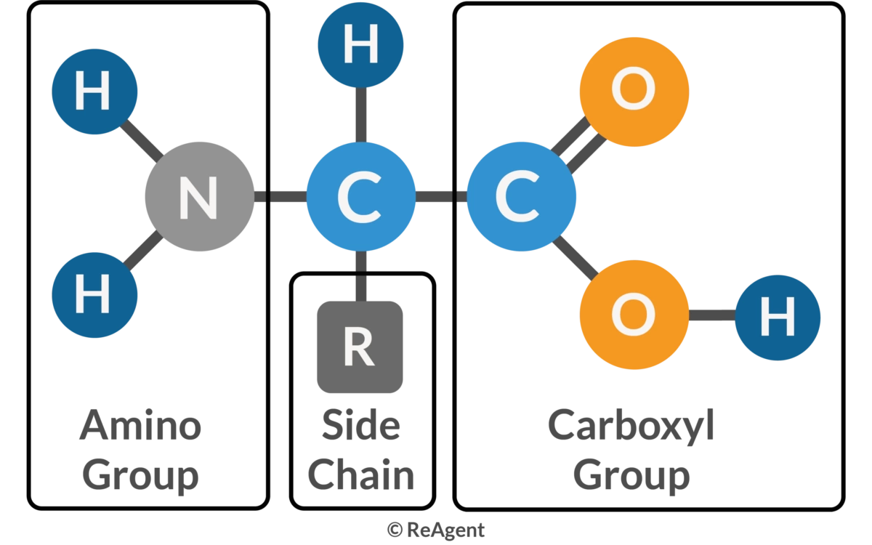

Slide 5
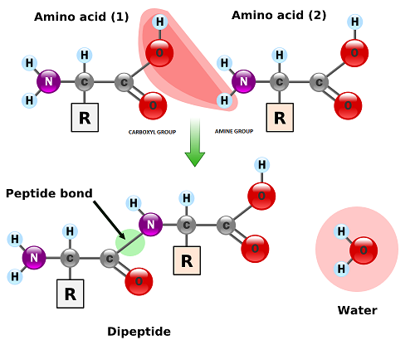
Peptide bond formation
https://study.com/learn/lesson/peptide-bond-formation-examples.html

Slide 6
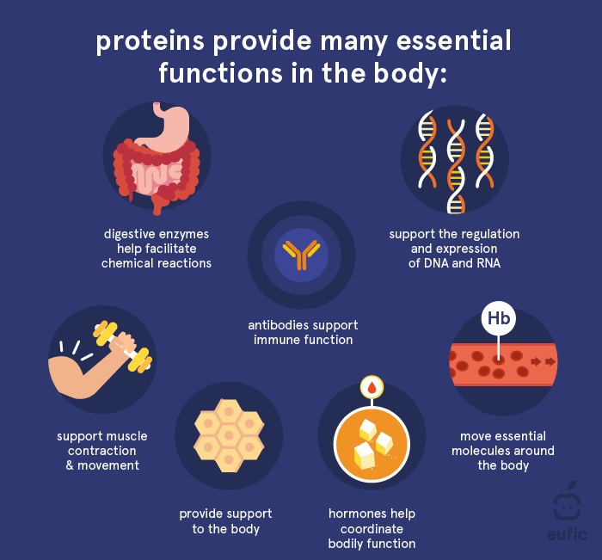
Functions of Proteins
Protein's main function is to build, maintain and repair all our body tissues.
Protein can also be used as energy source by body.
Some proteins have a protective or defensive function.
Proteins serve as the carrier and transporters of essential substances.
Types of proteins: Structural proteins & Regulatory proteins.
Structural proteins i.e., collagen or elastin
Regulatory proteins i.e., enzymes
https://www.eufic.org/

Slide 7
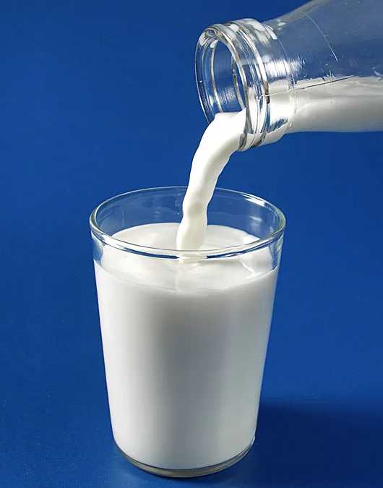
Milk Protein
Milk contains 3.3% total protein.
Contain all 9 essential amino acids required by humans.
There are two major categories of milk proteins,
casein and
whey proteins.
Milk proteins are synthesized in the mammary gland.
https://www.britannica.com/topic/milk

Slide 8
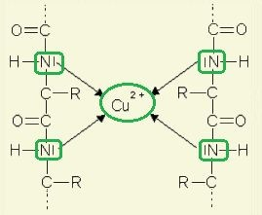
Principle
Reaction of Biuret reagent with peptide bonds forming chelate complex.
Cu (II) ion containing biuret reagents,
interact with a peptide bonds,
compound that contains at least four
resulting in the formation of violet/purple colored complex.
A color change from blue to violet indicates that proteins are present.
The greater the concentration of peptide bonds, the greater the color intensity.
Reaction of Biuret reagent with peptide bonds forming chelate complex.

Slide 9
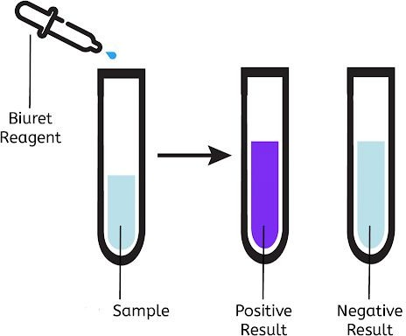
Principle (cont.)
If the concentration of peptide bonds is low, it results the color change is from the blue to pink.
Single amino acids (no peptide bonds present) and dipeptide (only 1 peptide bond present) which will give a negative result.
Peptides with at least four peptide bonds are required for the formation of the chelate complex.

Slide 10
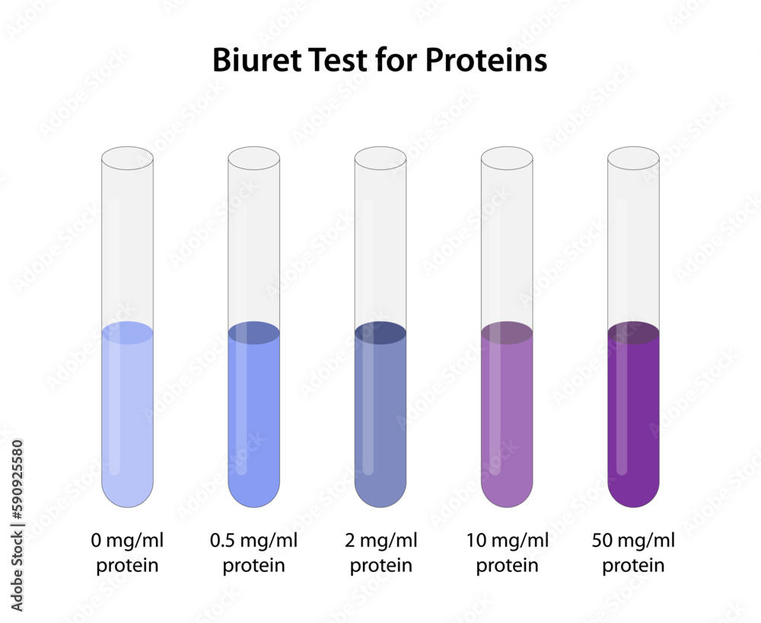

Slide 11
Biuret test
https://www.youtube.com/watch?v=WPCiGaT4uRI
https://www.youtube.com/watch?v=03fHlfA1TEc

Slide 12
EXPERIMENT
Apparatus
Procedure
Glassware
Test tubes
Test tube holder
Dropper
1. Add 2 ml of the milk sample to a clean and dry test tube.
2. Add 2 ml of biuret regent.
3. Repeat the steps above with distilled water to prepare a negative control.
Reagents
4. Shake well and allow the mixture to stand for 5 minutes.
□ Biuret reagents
Test sample (liquid milk)
Distilled water
5. Observe any color change.

Slide 13
Thank you!

